Slide 1

IDisposable Best Practices
C# Tips

Slide 2
IDisposable Interface
IDisposable is a .NET interface used to release unmanaged resources like memory, file handles, network, or database connections, which are not handled by the .NET garbage collector, to prevent resource leaks.
When a class implements IDisposable, a Dispose method is necessary. This method implements the logic to close or release unmanaged resources.

Slide 3
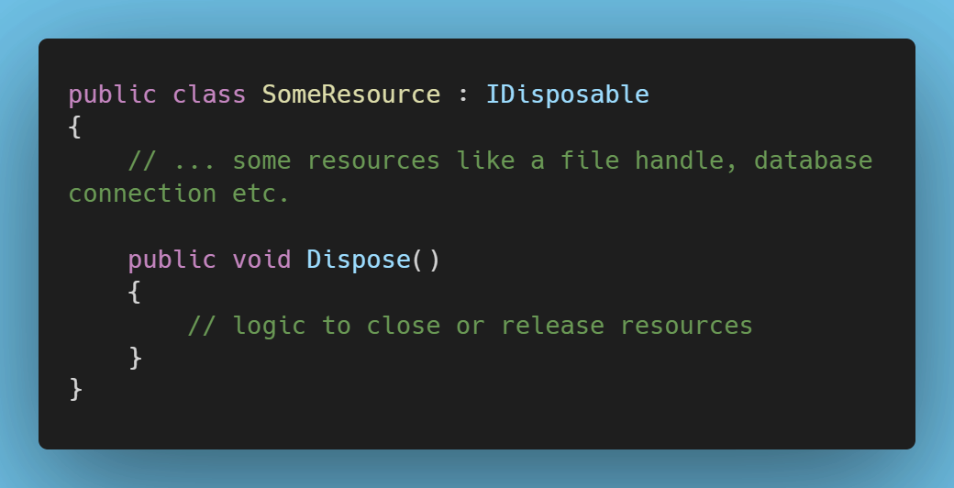
IDisposable Example

Slide 4
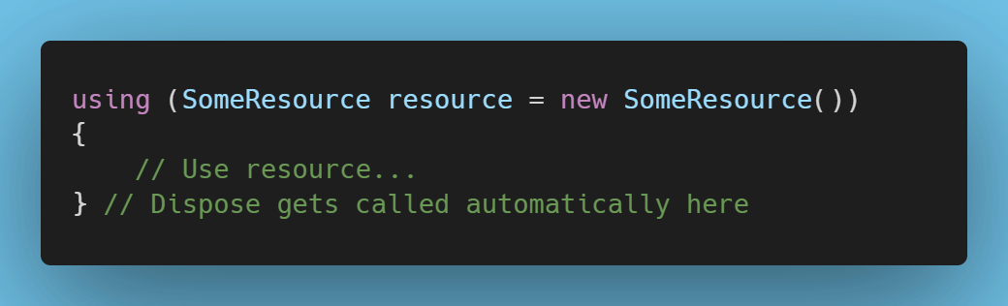
using
You typically use the using statement in C# when working with an IDisposable object. The using statement automatically calls the Dispose method, even if an exception occurs within the `using` block.

Slide 5
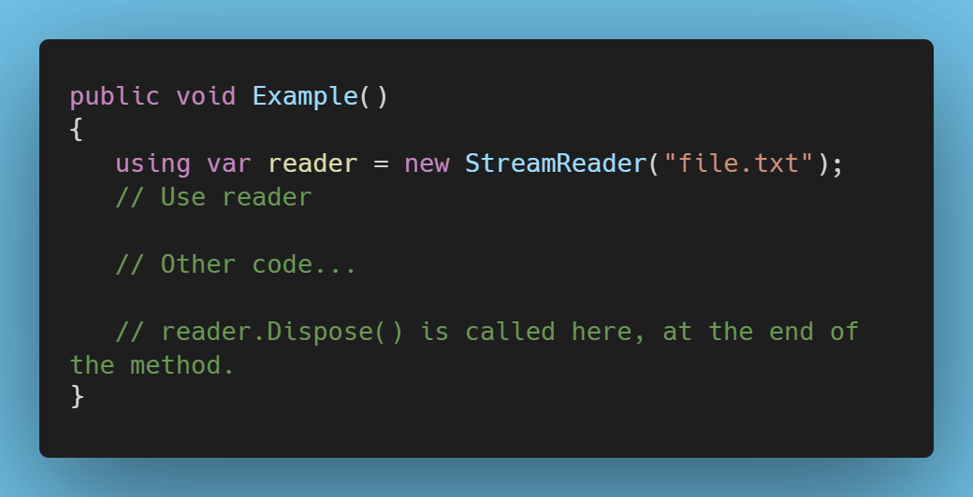
using var
using var is a feature that was introduced in C# 8.0. It's like the using statement, but with a slight difference: the scope of the object is not limited to the nearest enclosing block but extends to the end of the containing method. This can lead to more readable code since it avoids deeply nested blocks.

Slide 6
using var (cont’d)
The using var construct might delay resource disposal until a method's end, potentially causing resources to stay in memory longer if additional operations are run afterwards.
Delayed disposal with using var could cause issues if resources are scarce, costly, or if further long-running operations follow. It might be better to use the classic using statement if you want to ensure that resources are freed as soon as possible.

Slide 7
Get more tips at WickedProgrammer.com

